Slide 1
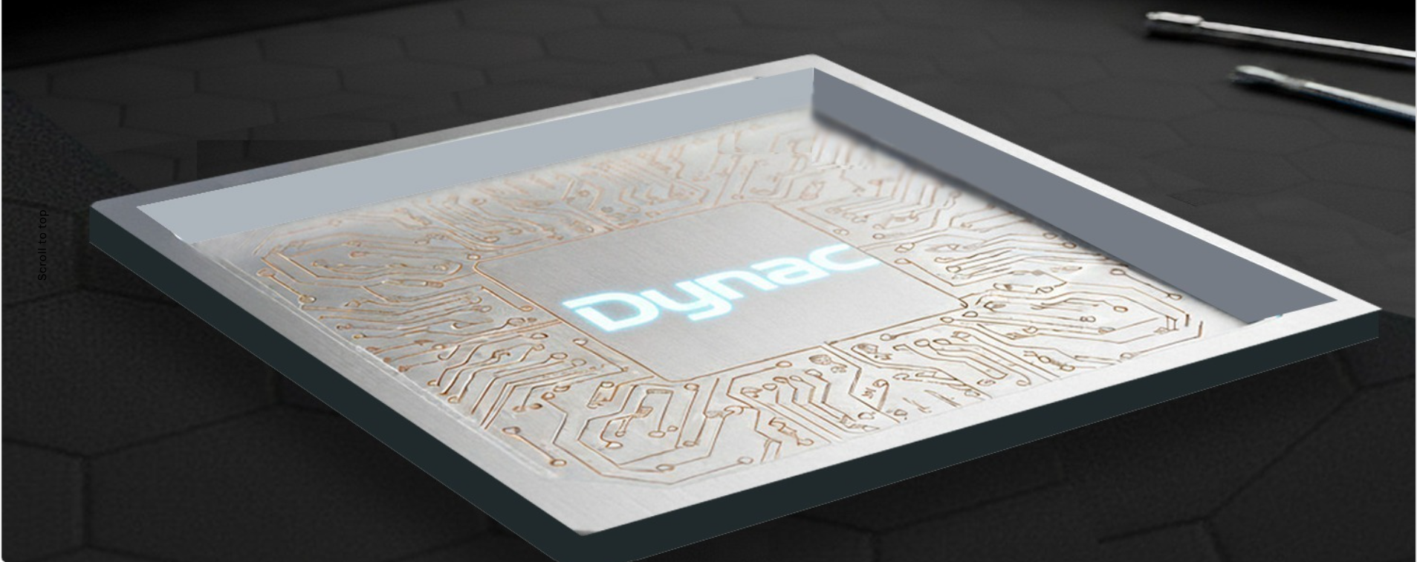

Metal-Diamond Heat Spreader
Dynacard co. Ltd

Slide 2


Slide 3


All Made in Taiwan
Welding — Opening a New Era of High-Power Chip Cooling
Reliable Mass Production
-- Fully In-House Technology Ensures Stable Supply to Global Server Leaders
Faster Delivery, Greater Reliability, Superior Cost Advantage
Twice as Fast-- Half the Delivery Time of Competitors
Delivering >600 W/m·K Superior Thermal Performance
Better Cost

Slide 4
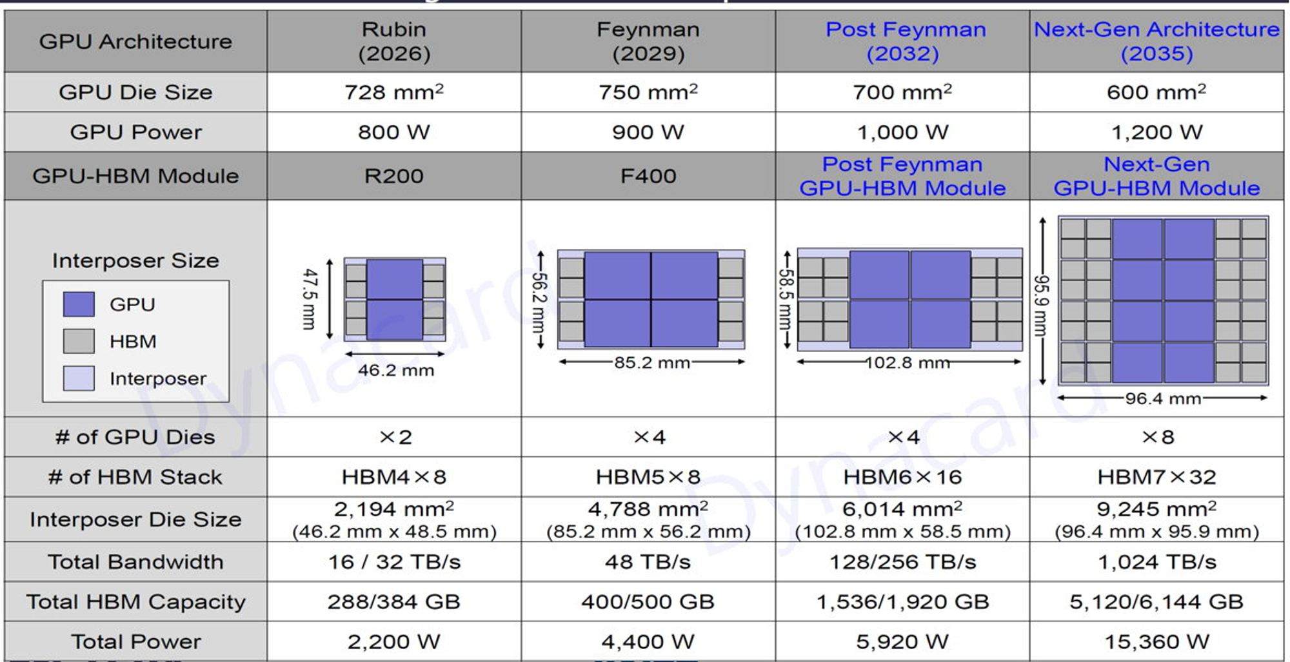
AI GPU power Consumption Roadmap

Slide 5
High Heat Flux Packaging Design & Cooling Requirement
With TIM
With Solder(Liquid Metal) TIM
CHIP
CHIP
TIM phaste, pad (3~20) W/(m·K)
Solder(liqiud Metal) 40~80 W/(m·K)
Thermal Conductive Material
(Graphene or VC)
Thermal Conductive Material
(Cu-Diamond)
- Low vertical thermal conductivity
- Relies on TIM materials
- Up to 8× higher thermal resistance
- VC may dry out or leak
- Superior thermal conductivity
vertically and laterally.
- Direct soldering to the chip
- Extremely low interfacial thermal resistance
- Strong metal bonding

Slide 6
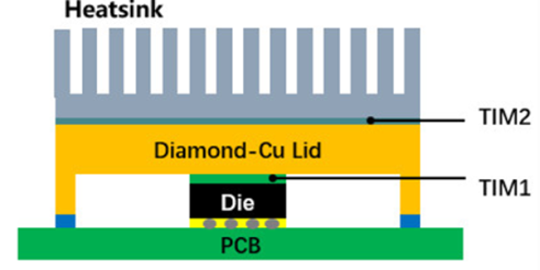
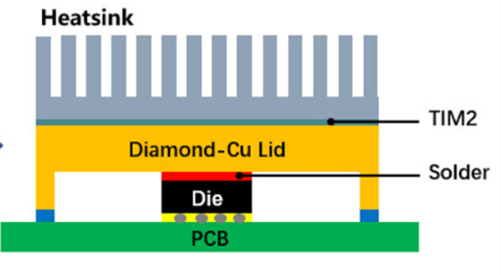
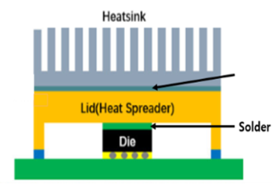
Thermal Interface Development Stages
STAGE 01
CU-Diamond + TIM1 + TIM2
STAGE 02
Cu-Diamond + Solder + TIM2
STAGE 03
CU-Diamond + Solder
+ Secondary Sintering
Secondary Sintering
High Interfacial
Thermal Resistance
TIM1 Resistance Reduced
Minimal Thermal Resistance
& Max Efficiency

Slide 7

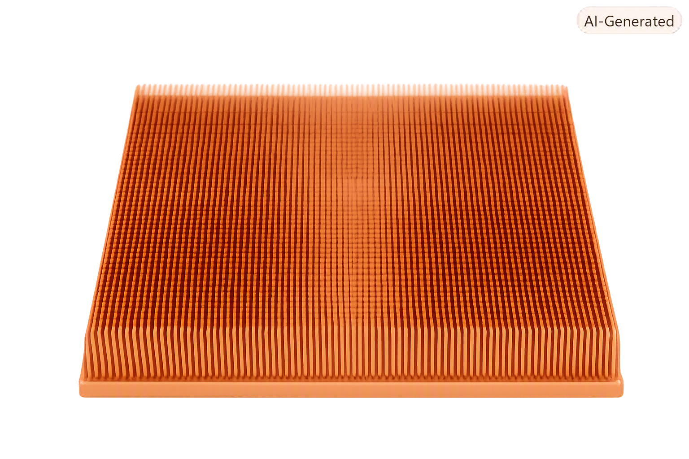
Microchannel Heat Sink

Slide 8


Designed for HPC
Heat dissipation requirements for
AI chips with power consumption of 1000W up
Effectively transfers heat to the coolant quickly
Spreads localized heat across the entire heatsink base
via the ultra-high thermal conductivity of diamond-copper,
ensuring rapid dissipation into the coolant

Slide 9


Alleviating thermal stress and strain
Under specific conditions, diamond-copper's superior CTE
compatibility allows for a rigid attachment to the chip material.
Optimizing for lightweight design
Diamond-copper features a density just 60% of traditional copper.
Combined with optimized flow channels and hollow designs,
it delivers a weight savings of more than 30%, enabling a truly lightweight design.

Slide 10
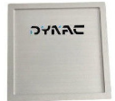
Basic Physical Properties (Typical Values)
Grade | Thermal Conductivity @ 25 °C W/(m·K) | CTE 25 – 150 °C (ppm/°C) | Density (g/cm³) | Flexural Strength (MPa)
DC600 | 600 – 700 | 5.5 – 7.5 (Adjustable) | 5.2 – 5.4 | ≥ 280
DC700 | 700 – 800 | 5.5 – 7.5 (Adjustable) | 5.2 – 5.4 | ≥ 280
DC800 | 800 – 900 | 5.5 – 7.5 (Adjustable) | 5.2 – 5.4 | ≥ 280
DC900 | ≥ 900 | 5.5 – 7.5 (Adjustable) | 5.2 – 5.4 | ≥ 280
Cu-Diamond
(Copper matrix, diamond-reinforced)
Grade | Thermal Conductivity @ 25 °C (W/m·K) | CTE 25 – 150 °C (ppm/°C) | Density (g/cm³) | Flexural Strength (MPa)
DA550 | 550 – 650 | 5 – 7 (Adjustable) | 3.1 – 3.3 | ≥ 350
DA650 | 550 – 650 | 5 – 7 (Adjustable) | 3.1 – 3.3 | ≥ 350
DA750 | ≥ 750 | 5 – 7 (Adjustable) | 3.1 – 3.3 | ≥ 350
Al-Diamond
(Aluminum matrix, diamond-reinforced)

